Slide 1
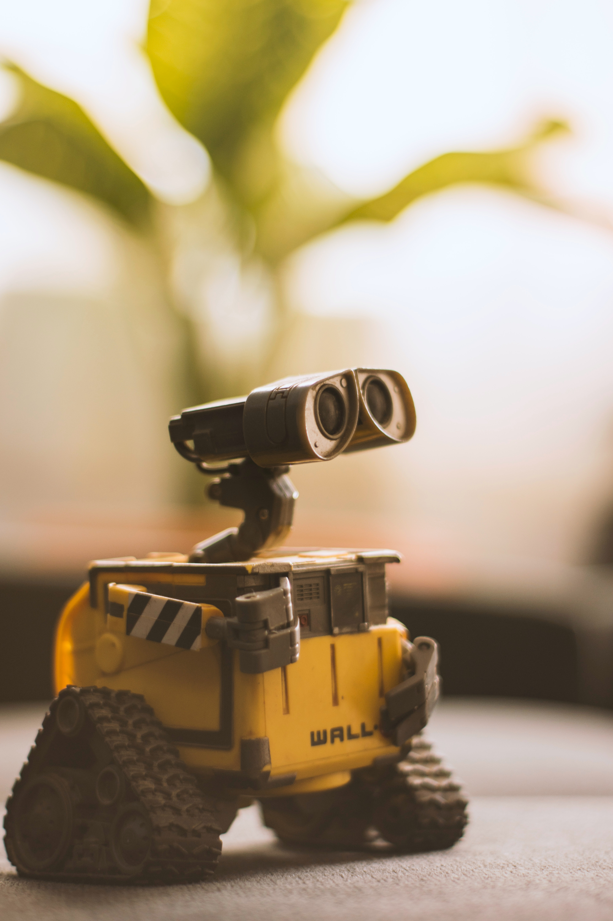
INTRODUCTION
COMPONENTS
IMPLEMENTATION
RESULTS
PRIMITIVE SHAPE DESIGNING BOT USING ROS
ROBOT
Presentation by Group 11

Slide 2
KEERTHI TEJ
TEAM MATES
PAVANI
YADHU VAMSI
SATHWIK GOWTHAM
INTRODUCTION
COMPONENTS
IMPLEMENTATION
RESULTS
AM.EN.U4AIE20027
AM.EN.U4AIE20033
AM.EN.U4AIE20039
AM.EN.U4AIE20064
SOURYA
AM.EN.U4AIE20074

Slide 3
TABLE OF CONTENTS
01
INTRODUCTION
02
COMPONENTS USED
03
IMPLEMENTATION
RESULTS
04
INTRODUCTION
COMPONENTS
IMPLEMENTATION
RESULTS

Slide 4
01
INTRODUCTION
INTRODUCTION
COMPONENTS
IMPLEMENTATION
RESULTS
What is a Robot?, What is ROS?, What is our project?

Slide 5
INTRODUCTION
INTRODUCTION
WHAT IS A
ROBOT?
INTRODUCTION
COMPONENTS
IMPLEMENTATION
RESULTS
“A Robot is an autonomous machine capable of sensing its environment, carrying out computations to make decisions, and performing actions in the real world.”​

Slide 6
INTRODUCTION
INTRODUCTION
ROS
ROBOT OPERATING SYSTEM
INTRODUCTION
COMPONENTS
IMPLEMENTATION
RESULTS
The acronym for ‘Robot Operating System’ is an open-source, meta-operating system for a robot. It provides the services you would expect from an operating system, including hardware abstraction, low-level device control, implementation of commonly-used functionality, message-passing between processes, and package management.​

Slide 7
INTRODUCTION
INTRODUCTION
WHAT IS OUR
PROJECT?
INTRODUCTION
COMPONENTS
IMPLEMENTATION
RESULTS
‘Path planning robot’ is the project we opted to do in this semester. When given a path as an input, the robot will move in that path. To demonstrate here, we have chosen to input a path resembling a shape. The robot takes the input and moves in such a way that it makes a shape resembling that particular shape. If further developed, our robot can be made to travel through a non-predetermined path by calculating its next moves. ​

Slide 8
02
COMPONENTS
INTRODUCTION
COMPONENTS
IMPLEMENTATION
RESULTS
Components used and what are they

Slide 9
COMPONENTS USED
COMPONENTS
INTRODUCTION
COMPONENTS
IMPLEMENTATION
RESULTS
MOTORS, WHEELS AND CHASIS
01
02
MOTOR DRIVER
RASPBERRY PI
03
04
UBUNTU

Slide 10
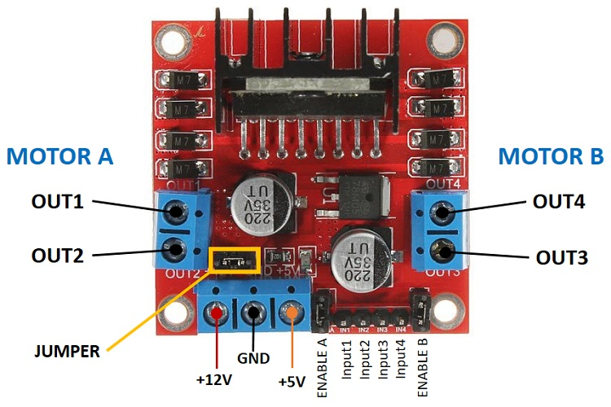

COMPONENTS
INTRODUCTION
COMPONENTS
IMPLEMENTATION
RESULTS
MOTOR DRIVER
UBUNTU
Motor drivers acts as an interface between the motors and the control circuits. Motor drivers take a low-current control signal and then turn it into a higher-current signal that can drive a motor. We use Motor driver L298N.​
Ubuntu is a free desktop operating system. It's based on Linux. Ubuntu is the most popular iteration of Linux on desktops and laptops. Ubuntu is one of the primary platforms for ROS.

Slide 11
COMPONENTS
RASPBERRY PI
3-B+
INTRODUCTION
COMPONENTS
IMPLEMENTATION
RESULTS
The Raspberry Pi is a low cost, single board and miniature sized computer that runs on Linux and connects to general peripherals like Keyboard and Mouse.
The dual-band wireless LAN comes with modular compliance certification, allowing the board to be designed into end products with significantly reduced wireless LAN compliance testing, improving both cost and time to market.
The Raspberry Pi 3 Model B+ maintains the same mechanical footprint as both the Raspberry Pi 2 Model B and the Raspberry Pi 3 Model B.

Slide 12
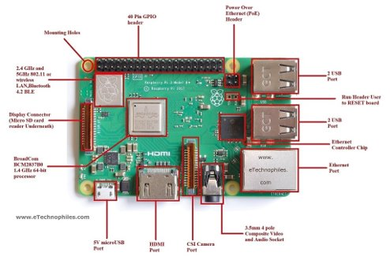
RASPBERRY PI
3-B+
COMPONENTS
INTRODUCTION
COMPONENTS
IMPLEMENTATION
RESULTS

Slide 13
03
IMPLEMENTATION
INTRODUCTION
COMPONENTS
IMPLEMENTATION
RESULTS
Hardware implementation & Software Implementation

Slide 14
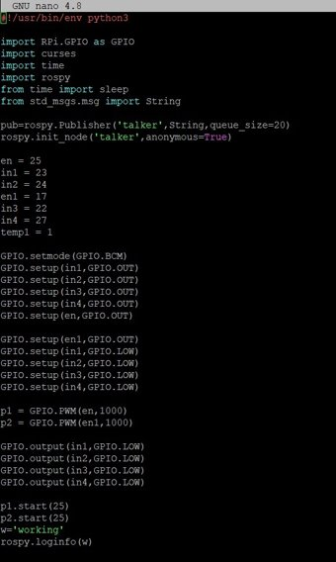
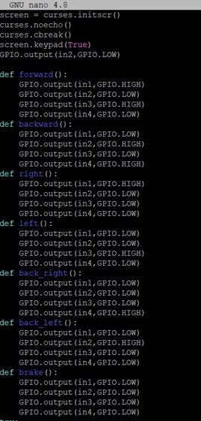
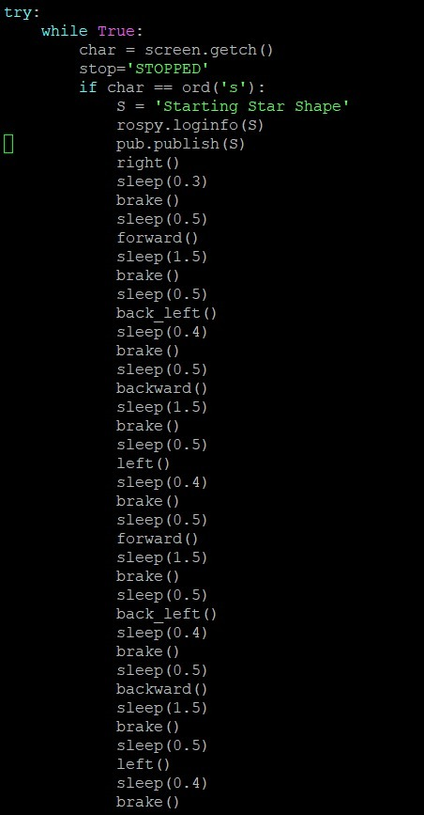
IMPLEMENTATION
INTRODUCTION
COMPONENTS
IMPLEMENTATION
RESULTS

Slide 15
04
RESULTS
INTRODUCTION
COMPONENTS
IMPLEMENTATION
RESULTS
Conclusion & Discussion

Slide 16
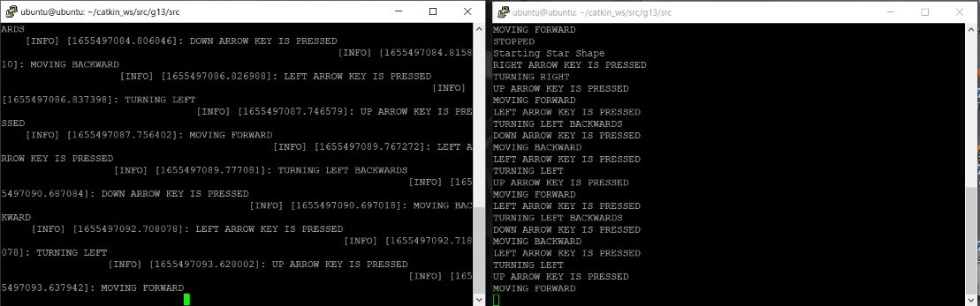
IMPLEMENTATION
INTRODUCTION
COMPONENTS
IMPLEMENTATION
RESULTS

Slide 17
THANK YOU !
INTRODUCTION
COMPONENTS
IMPLEMENTATION
RESULTS
A Presentation by Group-11

